Slide 1

Conveying information visually
Sean Oslin
DRAFT 3 10/26/19

Slide 2
What we’ll discuss
Preattentive attributes
Color
Good presentation practices with color

Slide 3
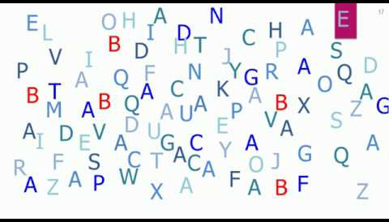
What are preattentive attributes?
Pre - before
Attentive - what you notice on a conscious level
Attributes - characteristics
Notes:
Definition: Visual property which is processed in spatial memory without our conscious action.
Think: immediate, instinctive, automatic
Or, what your eye is drawn to
And, FAST!

Slide 4
4 PAA properties
Color
Form
Mo--v---em-----en----------t
Spatial Positioning
Notes:
What are the 4 properities of preattentive attributes
Color is not just the color (red in this case). It also includes brightness and saturation.
Form includes size and shape. It also includes contrast with other shapes. For text, it includes font, italics, bold, underline, etc.
Movement relies on our reptilian brains to track watch moving objects, including shiny things
Spatial positioning is where an object is located in relation to other objects. Think of cluster analysis. Think of foreground and background.

Slide 5
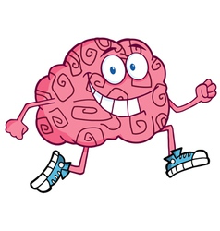
How fast your brain processes PAA?
5 seconds?
1 second?
.5 seconds?
.05 seconds?
Notes:
Our brain does some things faster than others. How long do you think it takes for your brain to respond to preattentive attributes?
Half a second. Time enough to react without thinking.
Split-second decisions are real.

Slide 6
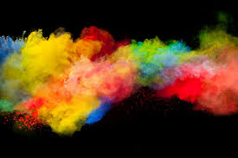
Color
Notes:
Color is comprised of 3 elements.

Slide 7
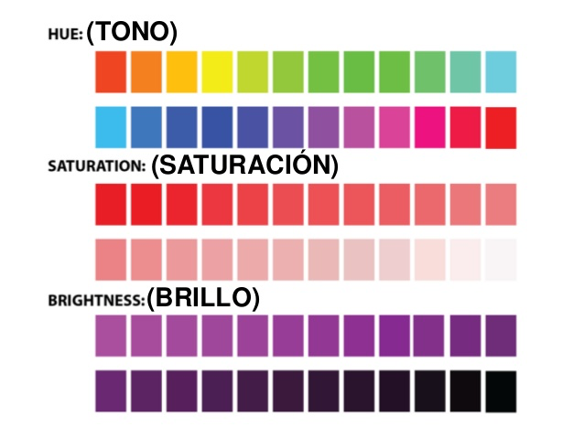
Color properties
Notes:
Let’s explore what we mean by these 3 concepts.
Hue is a measure of the color that we give a name to such as “Red” or “Violet”.
Saturation and lightness/brightness are a measure of color intensity.
Hues and intensities help us separate visual elements from their surroundings.
This saves the user from having to perform a visual search through data.
Here are some examples

Slide 8
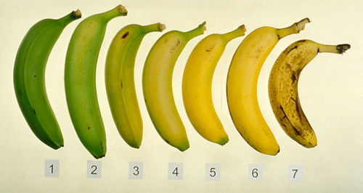
Hue: how ripe are my bananas?
Notes:
Hue is the easiest color concept to understand.
Example of how hue changes during the ripening process.
What number represents your ideal eating banana? Making banana bread?
How can you use hue to convey information?

Slide 9
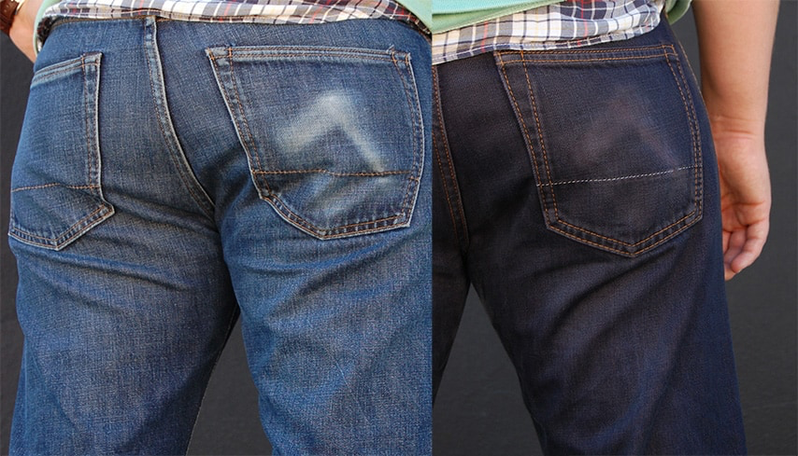
Saturation: same hue, different intensity
Notes:
Example: re-dying your jeans.
Color saturation is the intensity of a hue. It is the amount of grey in a color.
Maximum saturation is pure color. Minimum is washed out, faded, pastel, etc.

Slide 10
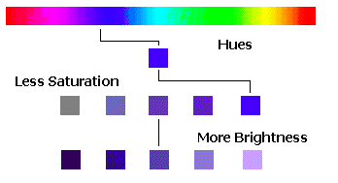
Brightness: it’s black & white
Notes:
Brightness is the relative lightness or darkness of a particular color, from black (no brightness) to white (full brightness).
Brightness is also called Lightness in some contexts. In Tableau, saturation is called Opacity and is measure as a percent.
The difference between saturation and brightness is very important in photography and image processing applications. It is less important in creating visualizations using charts and graphs.
The takeaway: if you want turn a blue sky grey, lessen the saturation. If you want to make a dark blue sky a lighter shade of blue, increase the brightness.

Slide 11
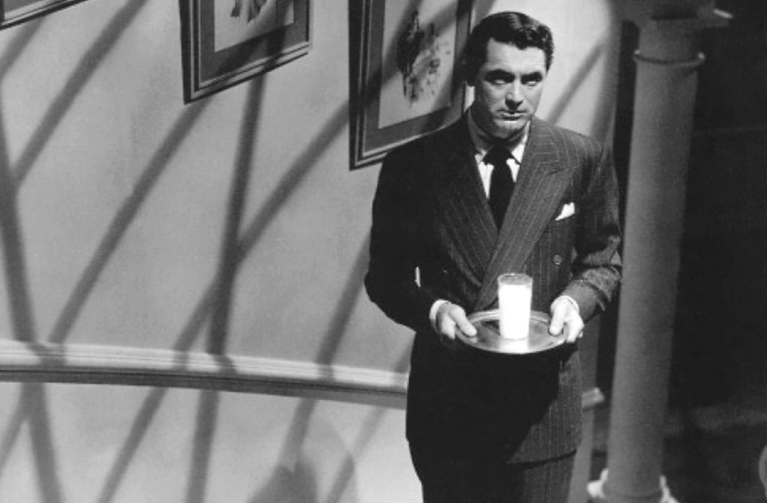
Notes:
Example of brightness:
Cary Grant in Alfred Hitchcock’s Suspicion (1941)
Where does your eye go in this movie still? Why?

Slide 12
Why does color saturation and brightness matter?
We are drawn to pure, intense colors
Important points should be in intense colors – where you want people to look
Supporting elements, including grid lines, axes, etc. should be less intense
Creates a 3D effect
‘He faded into the background.’

Slide 13
Notes:
Color and color intensity help keep visual elements in the foreground or move them to the background.

Slide 14
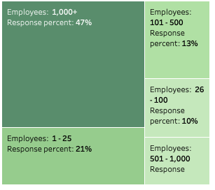
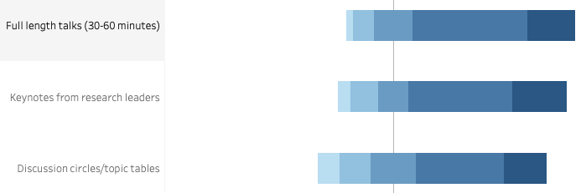
Using intensity to convey information – 2 colors
Notes:
Also, using a continuum of saturations for a single color allows us to add variety to a presentation without overwhelming our eyes with too many colors.
In these examples, brightness is coupled with geometric area to convey information about the relative strength/size/importance of each data element. Visualization software has color-blind palettes. I use these frequently.

Slide 15
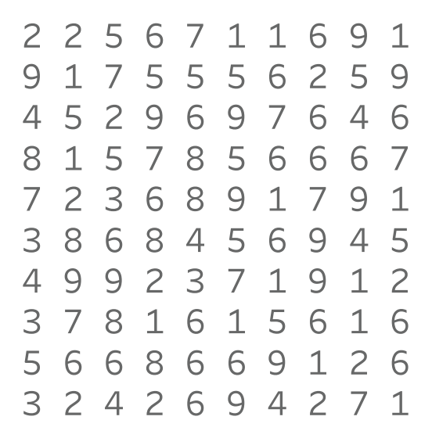
How many 9s?
Notes:
Color helps as pick details out of a crowd.

Slide 16
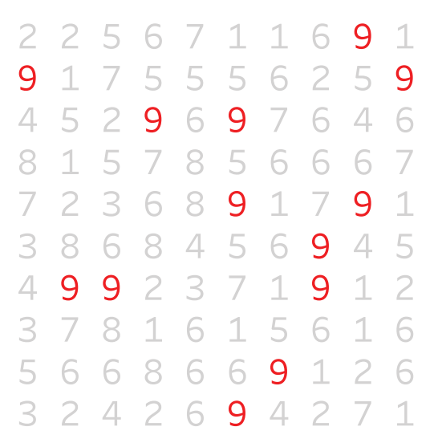
Easier?
Notes:
Our eyes are drawn to the color.
You see this technique used in crowd scenes in movies and TV shows.

Slide 17
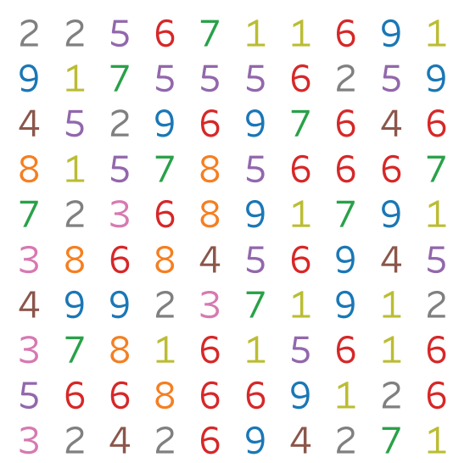
How about now?
Notes:
Too much color is as bad as none at all.
Remember: colors are accents. Also, black is an accent color in visualizations.

Slide 18
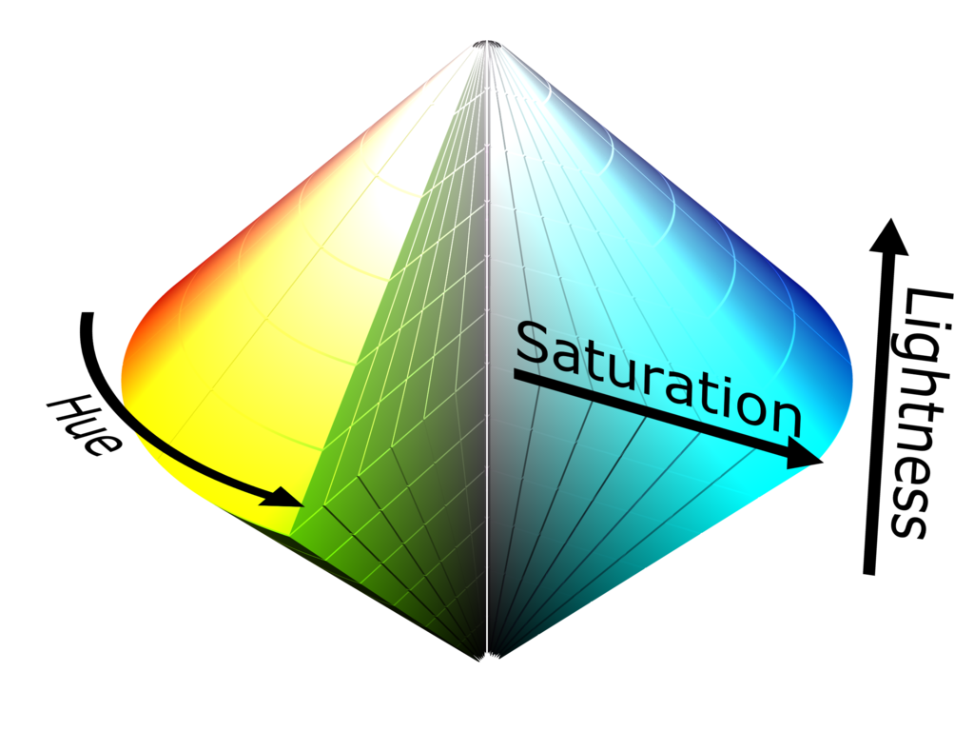
Hue, saturation, brightness (lightness)
Notes:
Here is another visual explaining the difference between hue, saturation and brightness.

Slide 19
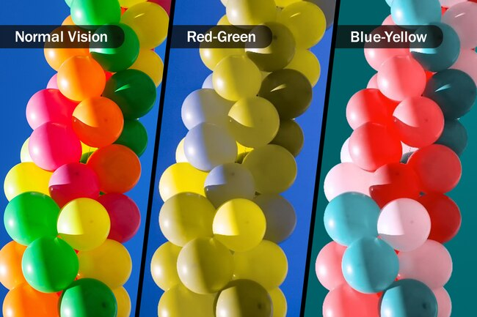
Color blindness
Notes:
Color blindness affects approximately 1 in 12 (8%) in men of all races, and much higher among white men. About 1 in 200 women in the world are color blind
There are 3 types (only 2 are shown), with red-green being the most common. Be aware of this when combining colors.
Visualization software packages have color blind palettes
You can use red and green in visualization, just not together.

Slide 20
Notes:
Beware of stoplight colors, not just because of color blindness, but also the psychological effect if you are writing a report (red is BAD!, green in GOOD)

Slide 21
Color-blind palette in Tableau

Slide 22
Takeaways
Colors are for emphasis/accent - use sparingly!
Contrast gives a sense of balance (red/blue, orange/purple)
Black is an accent color – use greys
Color code your visuals to the type of graph (e.g. bar charts are blue, line charts are red, treemaps are green)
Be aware of colorblindness
Be conservative, use (develop!) some color taste

Slide 23
Color and working with clients
When you create a draft of a data viz, only use grayscale colors.
Customers may be preoccupied with color choice and ignore what is being communicated.
Take color out of the mix to help focus their attention on the content. Add color once all decisions are made
Notes:
Keep in mind brand colors that may need to be used. Be careful if they mix reds and greens.

Slide 24
Form
Form can be manipulated to either call attention to a member of the data set or to reduce our attention on it.

Slide 25
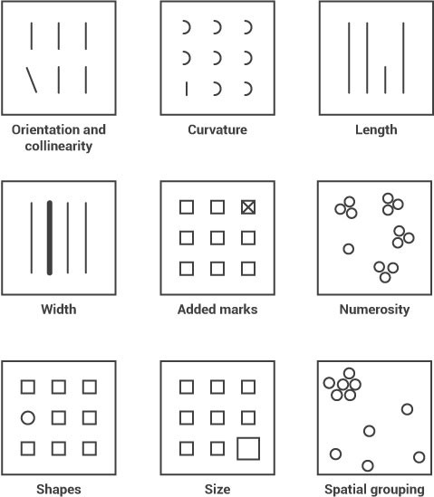
What seems to be missing?

Slide 27
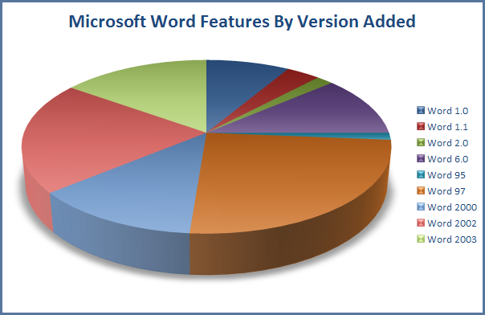
No, NO, NO!!!!
Proportions
and 3D
(also, too much color and no labels)
What would be a better chart type?

Slide 28
